Slide 1
Basic Slack Integration for Leginon
New York Structural Biology Center
Simons Electron Microscopy Center
National Resource for Automated Molecular Microscopy
09/27/2017 (updated 3/31/19 by Anchi Cheng)
Carl Negro

Slide 2
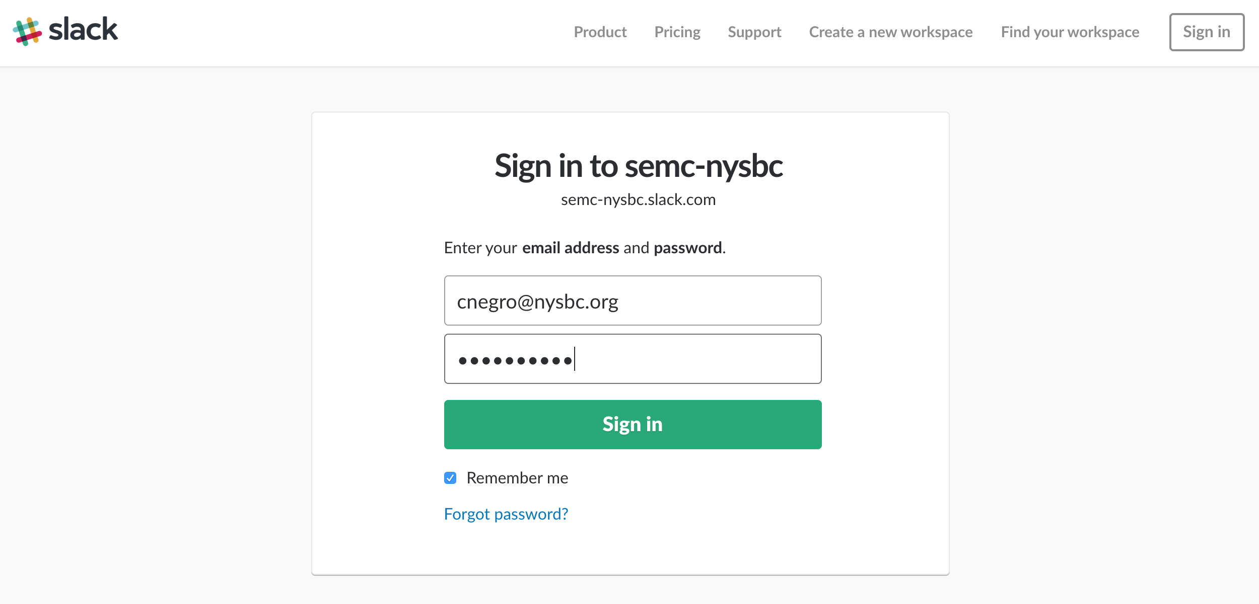
Sign in to you workspace

Slide 3
Navigate to https://api.slack.com/apps; “Create New App”

Slide 4
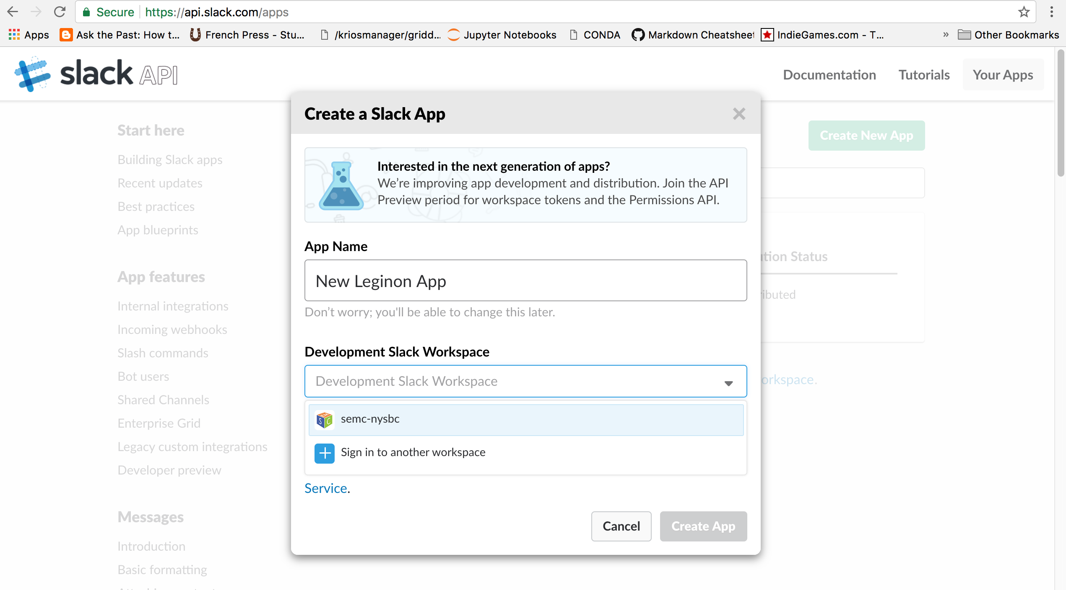
Name the app; select your workspace; “Create App”

Slide 5
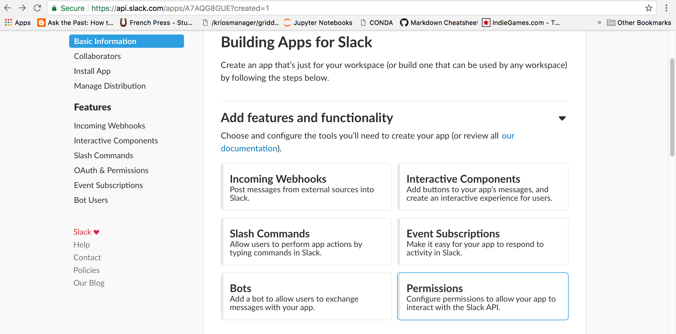
Scroll and click“Permissions”

Slide 6
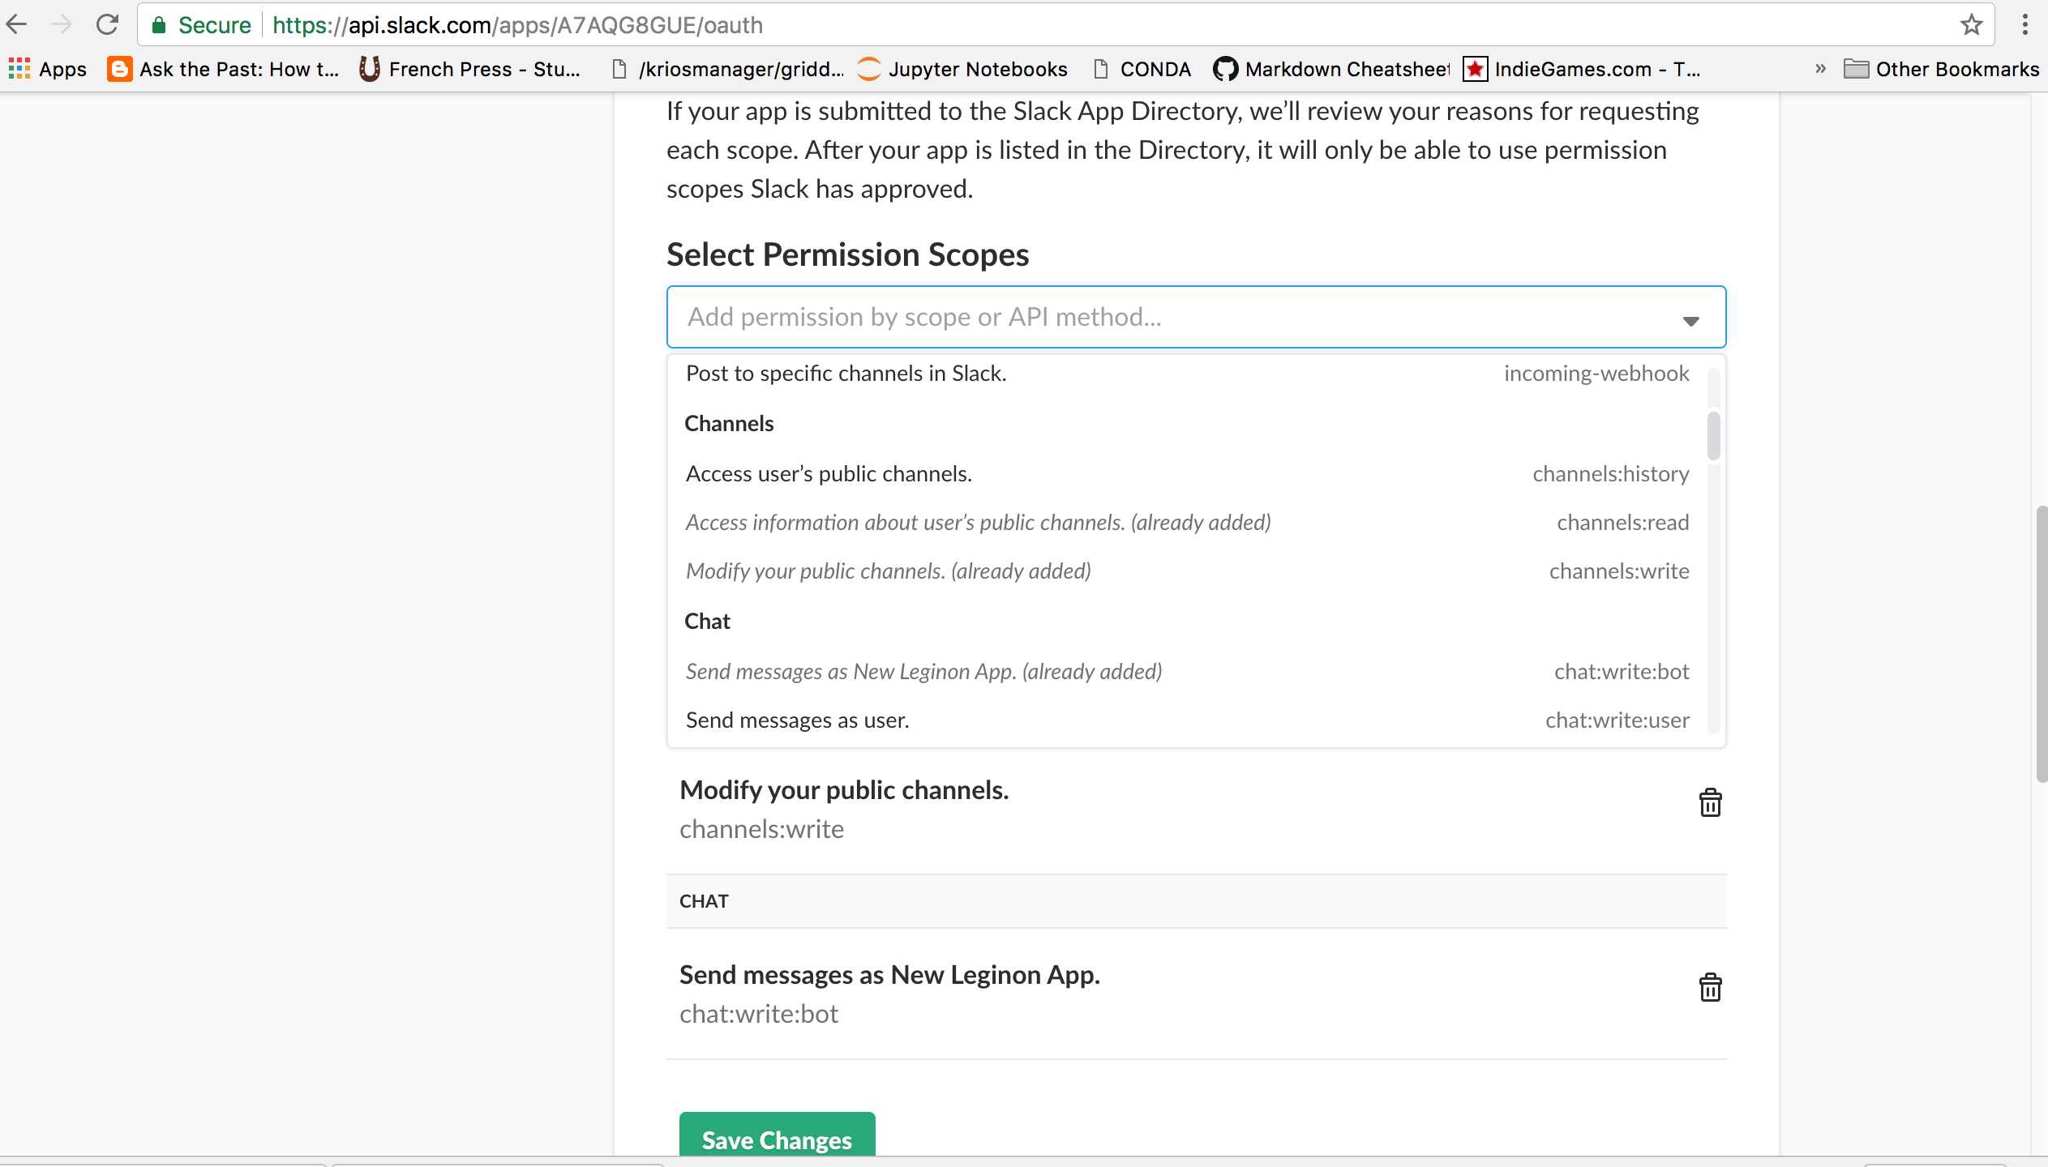
Scroll to “Scopes”; add these permissions: bot, channels:read, channels:write, chat:write:bot. Click “Save Changes”

Slide 7
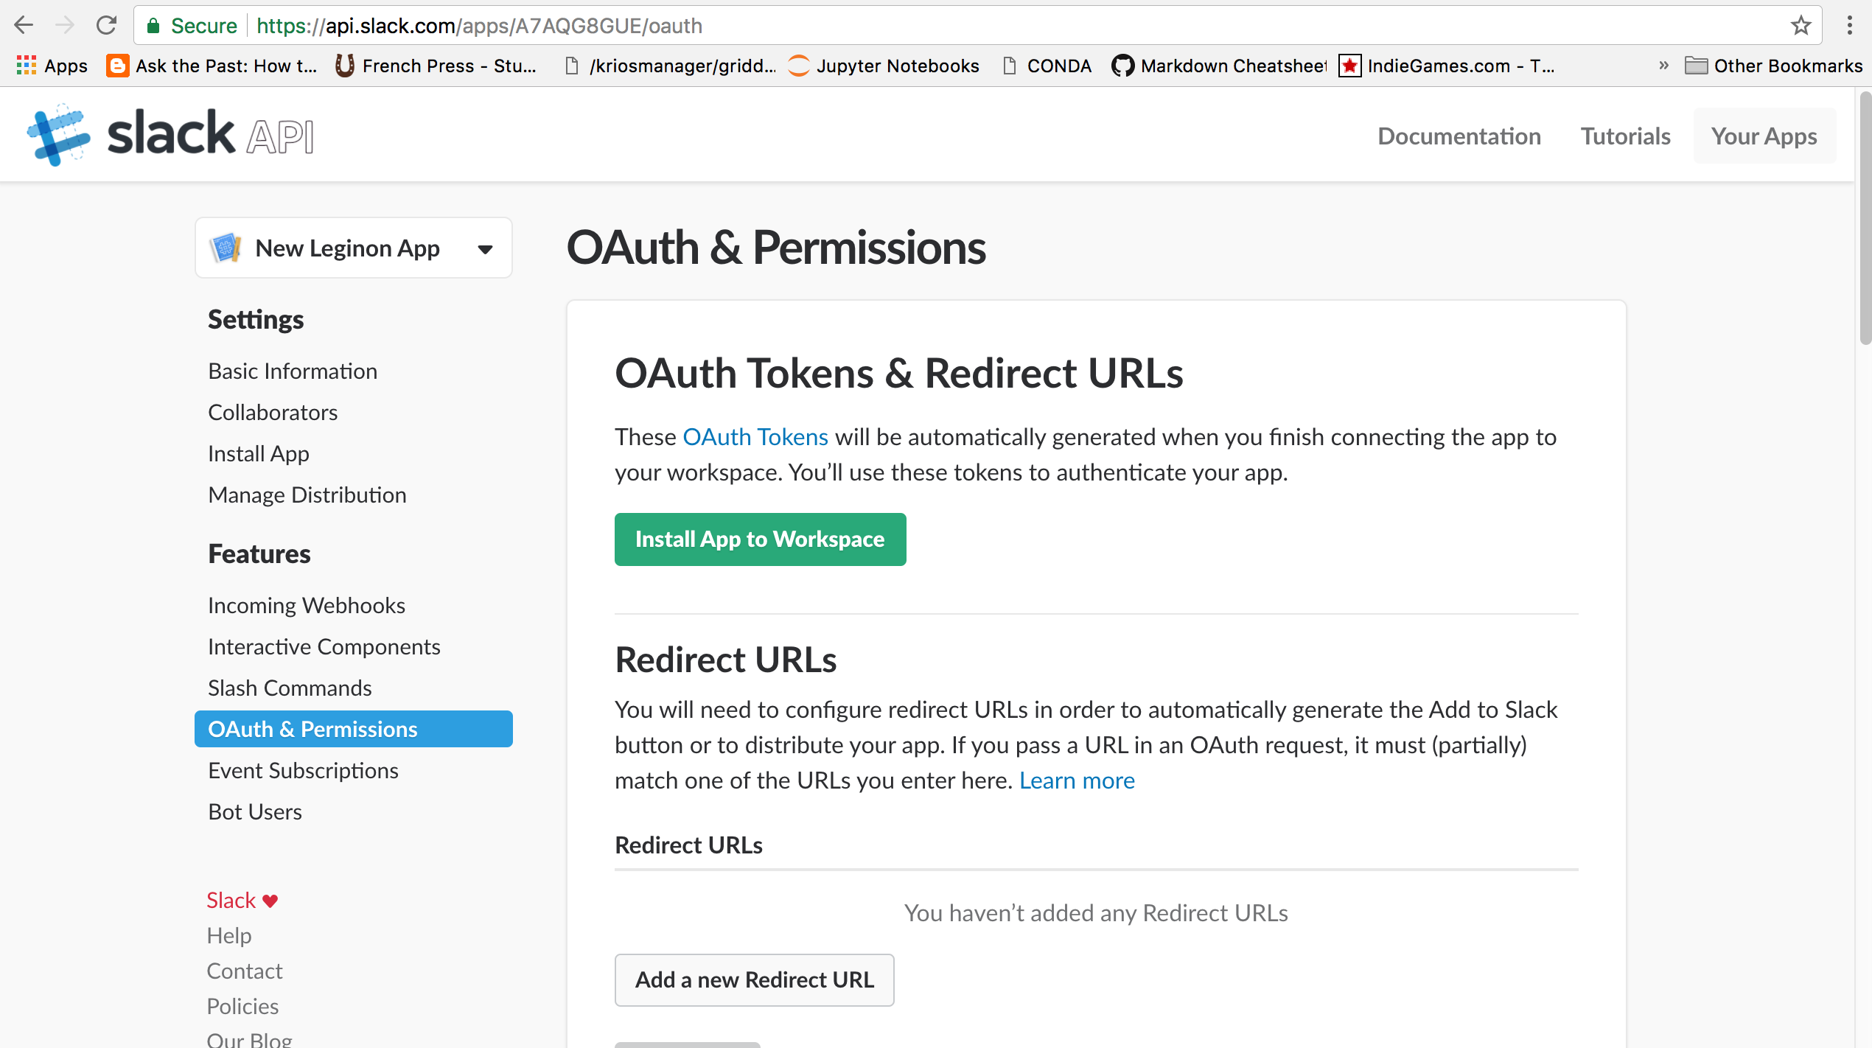
Scroll up or go to “Install App”. Click “Install App to Workspace”

Slide 8
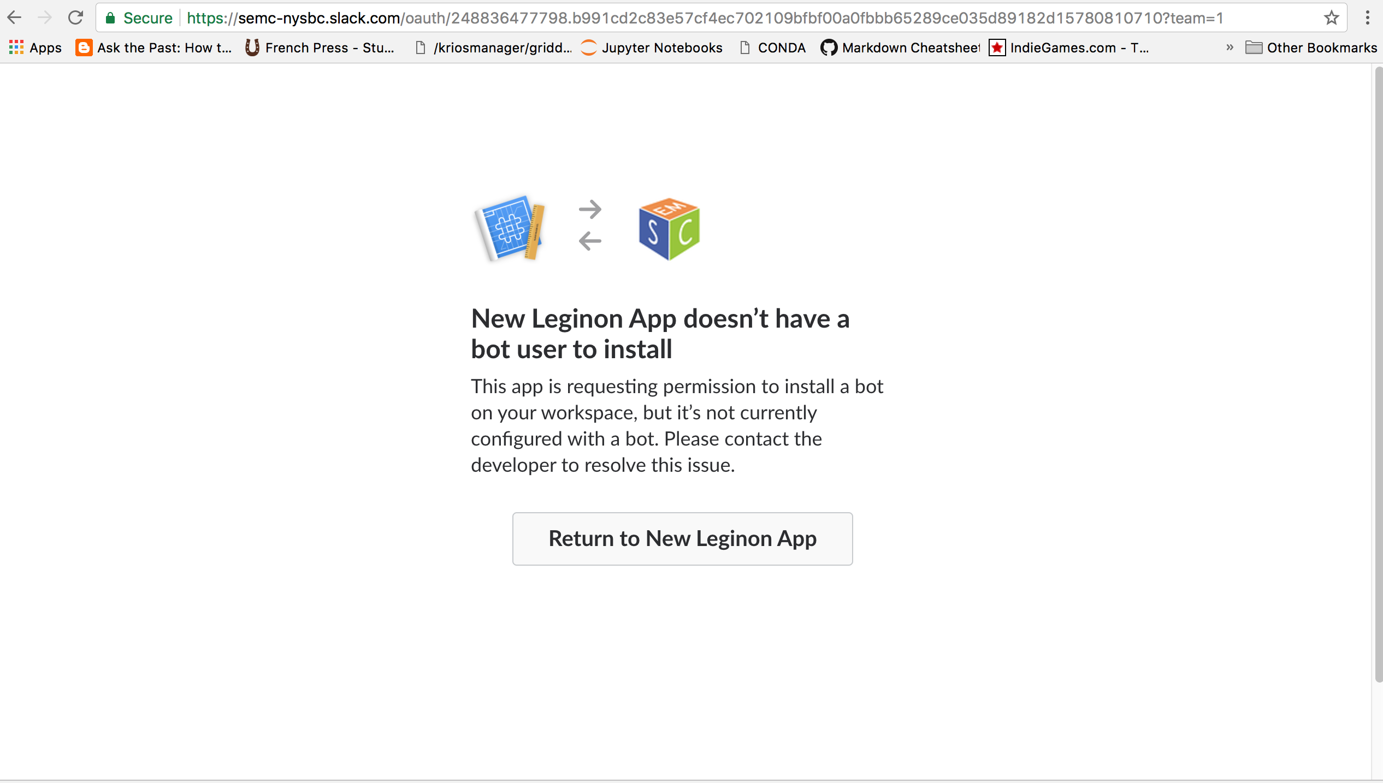
We don’t have a bot user, click “Return to New Leginon App”

Slide 9
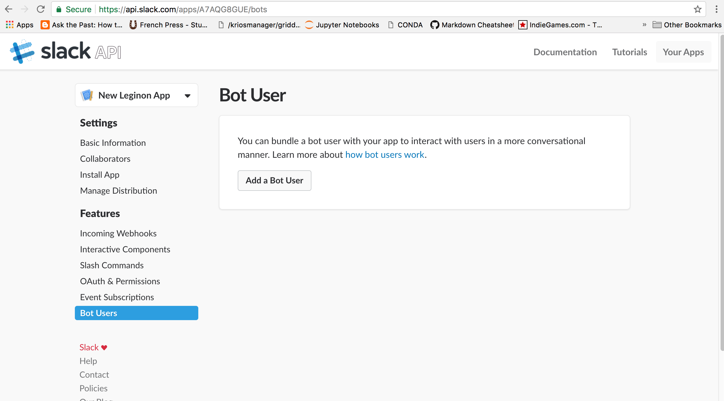
Click “Bot Users”, then “Add a Bot User”

Slide 10
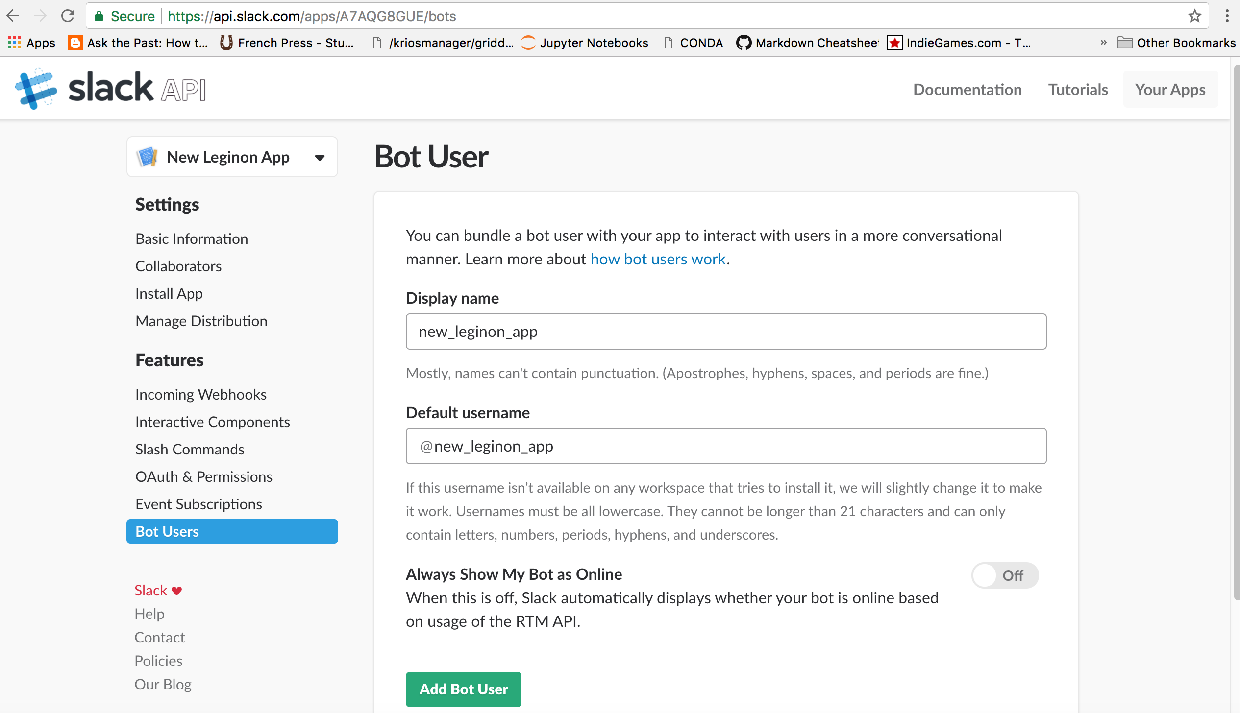
Select a display name and default username; click “Add Bot User”

Slide 11
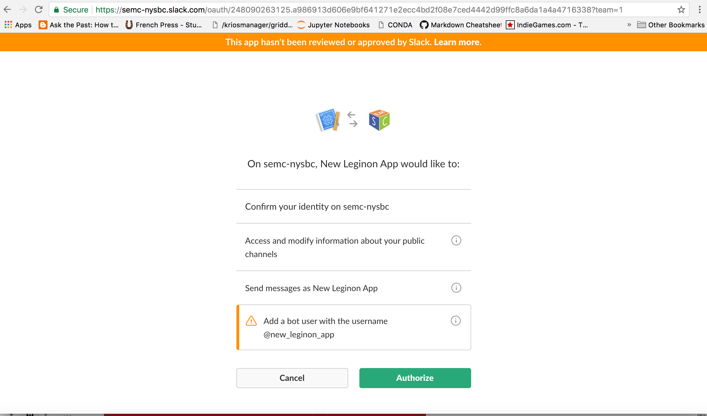
Return to “Install App in Workspace”; click “Authorize”

Slide 12
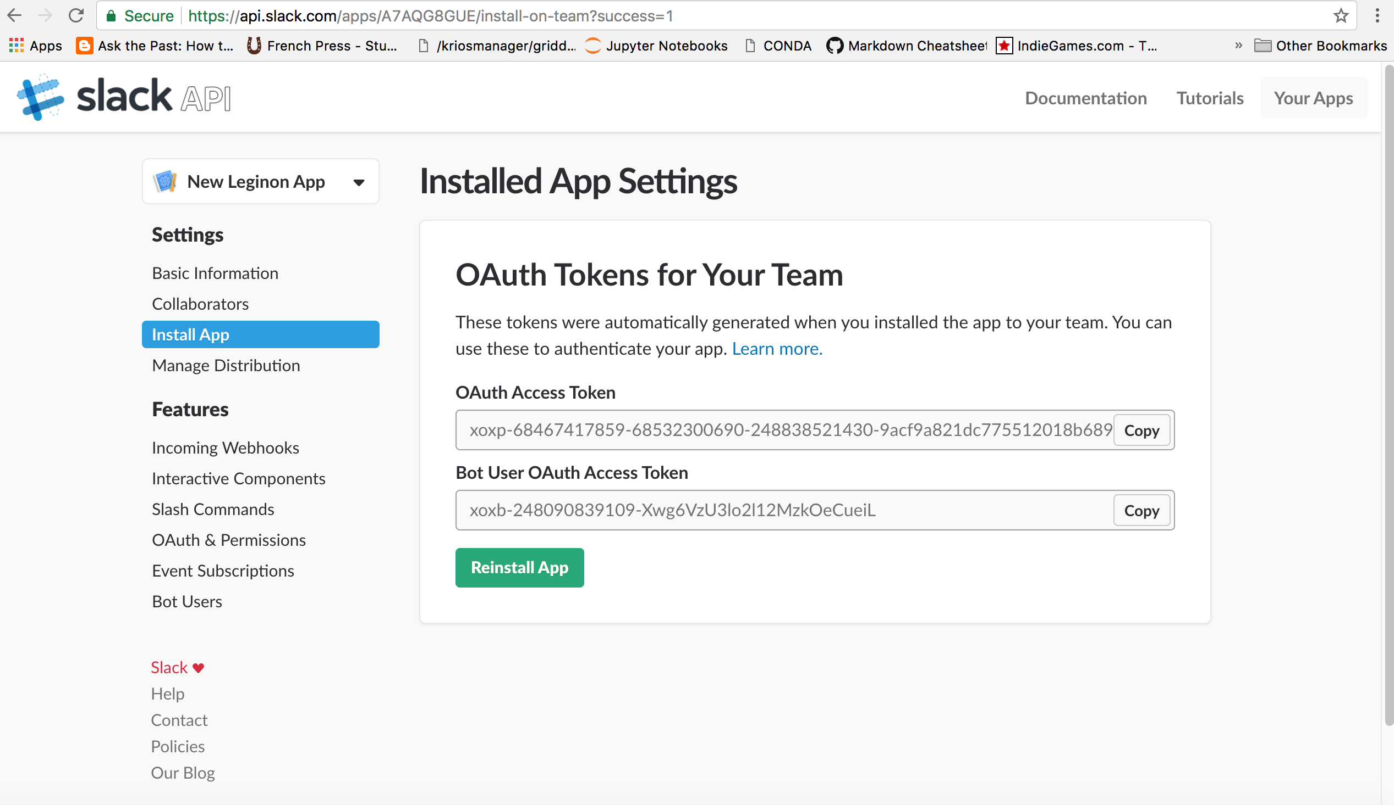
Copy the OAuth Access Token, paste it to slack.cfg

Slide 13
Copy ~/myami/slack/slack.cfg.template to /etc/myami/slack.cfg on your Leginon workstation. On the line “slack_token:” add your “Bot User Oauth Access Token”. Add a default channel, where messages will be sent if no channel is specified. Leave the “virtualenv_path” field as is.

Slide 14
For CentOS, run `sudo yum install python-pip` if pip is not installed.
For Ubuntu/Debian systems, run `sudo apt-get install python-pip`.
run `sudo pip install slackclient==1.0.0` .
(note the version, the latest version will break with python2.6! Nor it will be allowed to overwrite the system package requests even though it is python 2.7)
CentOS 6 python 2.6
run `sudo pip install requests=2.18.4`.
Check that it works by importing the module in python command line
shell>python
Python> import slackclient

Slide 15
Navigate to your_download/myami/slack; `git pull origin trunk` if necessary. execute `python slack_test.py`; (ignore warnings) You should see a slack message if successful.

Slide 16
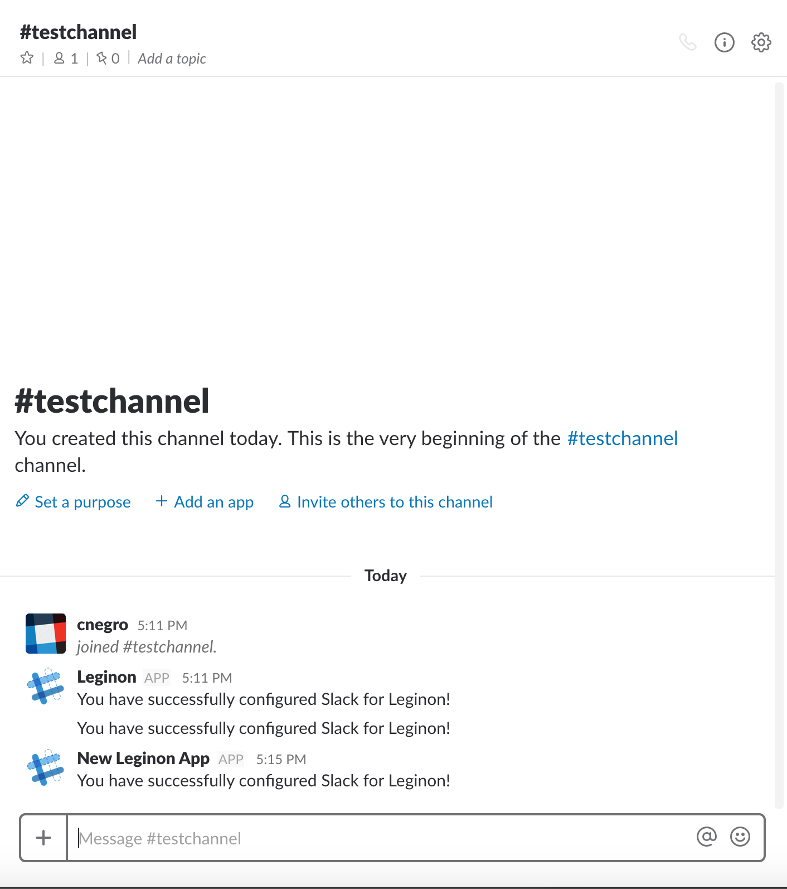
Success!

Slide 17
Use the following code snippet to send messages to Slack:
You can also set checkchannel=True in the sendMessage method to automatically create a channel if it does not exist, otherwise you will get an error.

Slide 18
Done!

