Slide 1
Basic Slack Integration for Leginon
New York Structural Biology Center
Simons Electron Microscopy Center
National Resource for Automated Molecular Microscopy
09/27/2017
Carl Negro

Slide 2
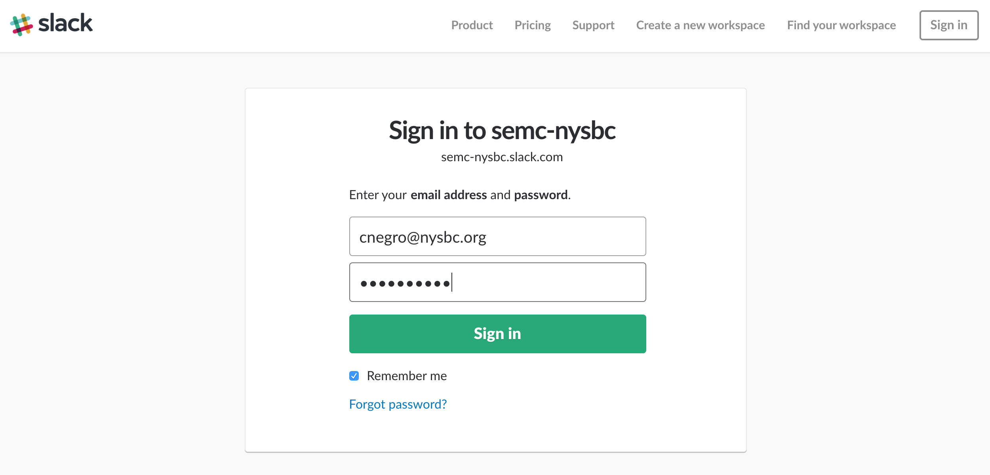
Sign in to you workspace

Slide 3
Navigate to https://api.slack.com/apps; “Create New App”

Slide 4
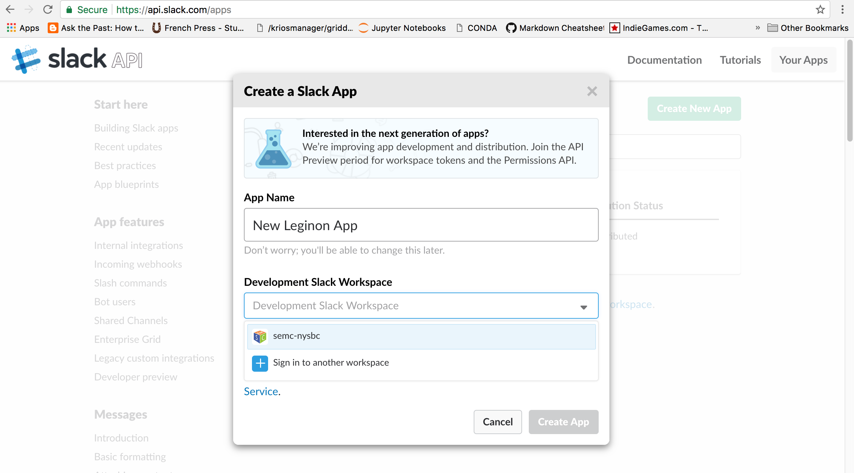
Name the app; select your workspace; “Create App”

Slide 5
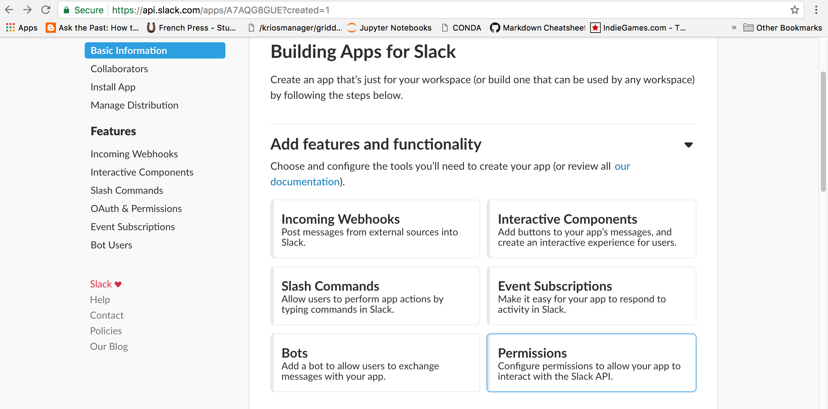
Scroll and click“Permissions”

Slide 6
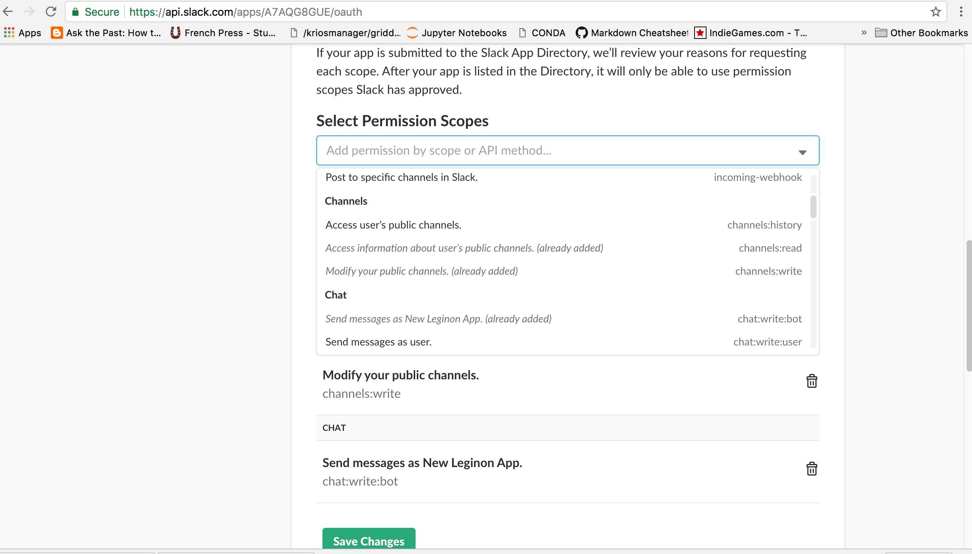
Scroll to “Scopes”; add these permissions: bot, channels:read, channels:write, chat:write:bot. Click “Save Changes”

Slide 7
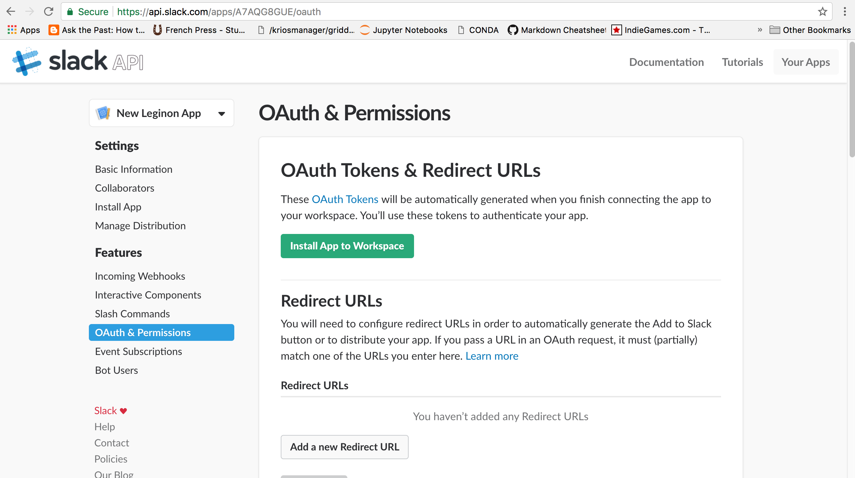
Scroll up or go to “Install App”. Click “Install App to Workspace”

Slide 8
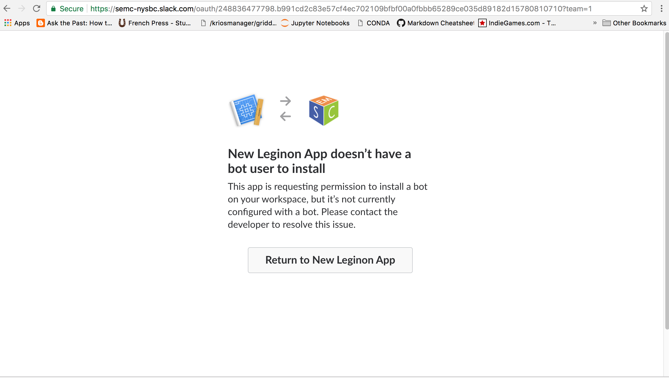
We don’t have a bot user, click “Return to New Leginon App”

Slide 9
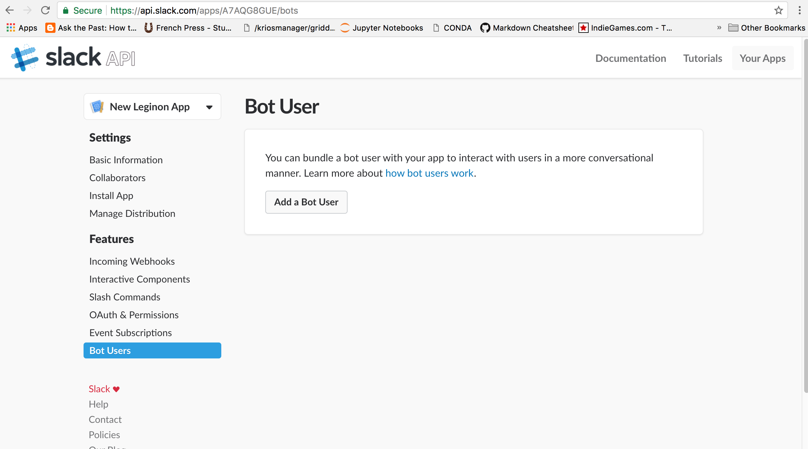
Click “Bot Users”, then “Add a Bot User”

Slide 10
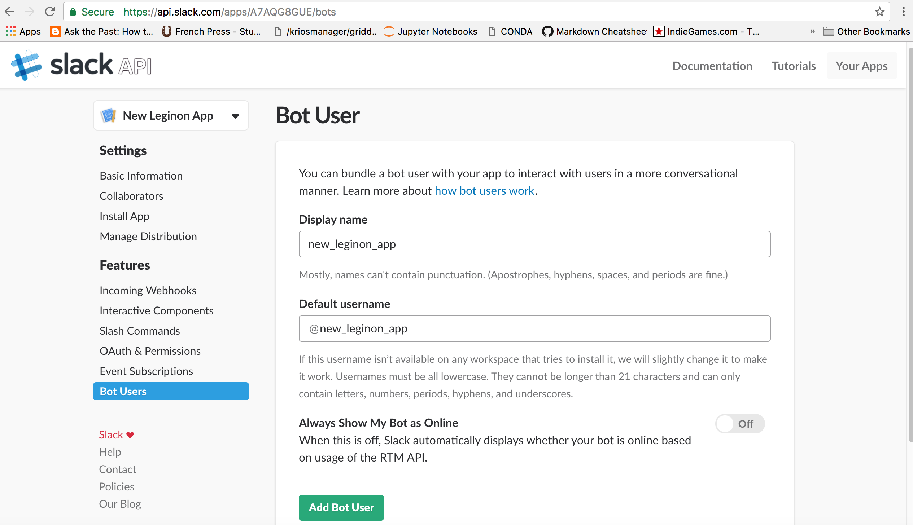
Select a display name and default username; click “Add Bot User”

Slide 11
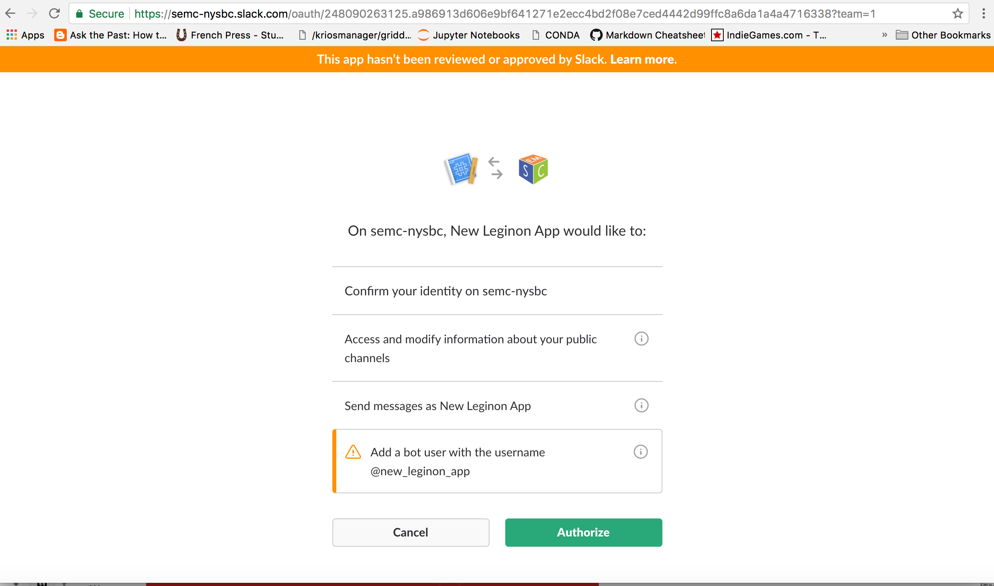
Return to “Install App in Workspace”; click “Authorize”

Slide 12
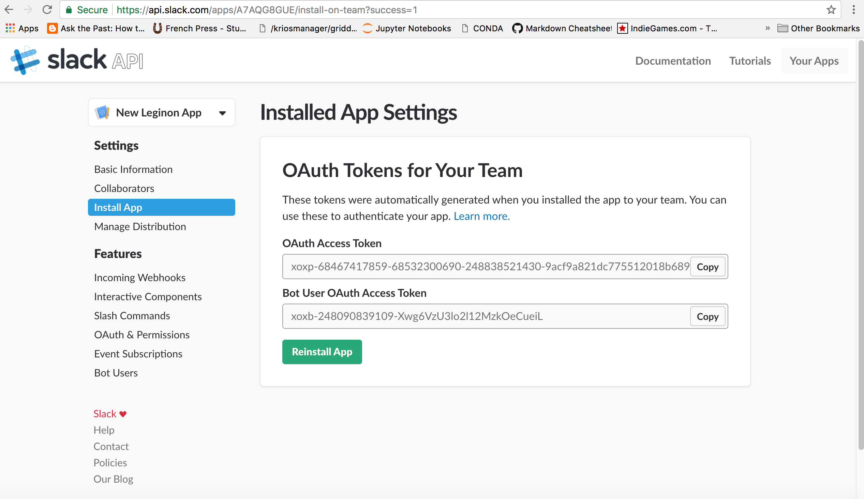
Copy the OAuth Access Token, paste it to slack.cfg

Slide 13
Copy slack.cfg to /etc/myami/slack.cfg on your leginon machine, on the line “slack_token:”. (Ignore virtualenv_path)
Run `sudo yum install python-pip` if pip is not installed.
Run `sudo pip install slackclient==1.0.0` .
(note the version, the latest version will break with python2.6!)

Slide 14
Navigate to ~/myami/slack; `git pull origin trunk` if necessary. execute `python slack_test.py`; (ignore warnings) You should see a slack message if successful.

Slide 15
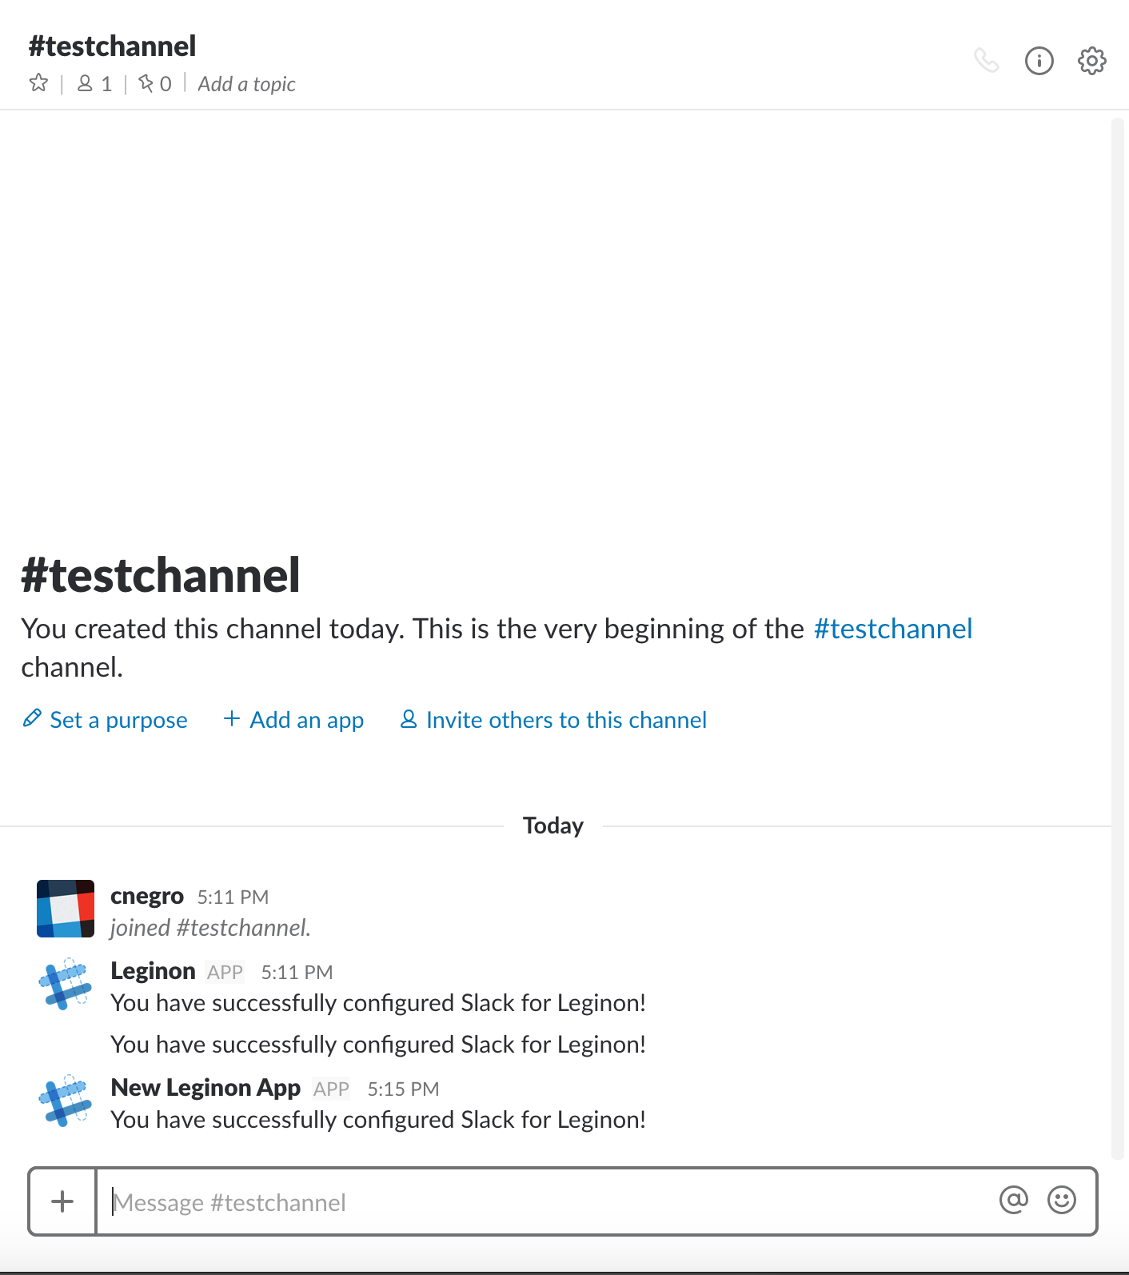
Success!

Slide 16
Use the following code snippet to send messages to Slack:
You can also set checkchannel=True in the send_message method to automatically create a channel if it does not exist, otherwise you will get an error.

Slide 17
Done!

